Slide 1

Phishing Attacks
No, not that kind
Presented by

Slide 2
What is phishing?
A criminal activity using social engineering techniques (a collection of techniques used to manipulate people into performing actions or divulging confidential information).
Phishers attempt to fraudulently acquire sensitive information, such as usernames, passwords and credit card details, by masquerading as a trustworthy entity in an electronic communication.

Slide 3






Common targets
eBay and PayPal are two of the most targeted companies, with online banks following closely behind.
Social network sites are often targeted to gain information for identity theft.

Slide 4

How is Phising done?
E-mail
Your bank needs you to reset your password
Links
A link to facebook in a Youtube comment
Man in the middle (Mitm)
Targeted attack, largely undetectable

Slide 5
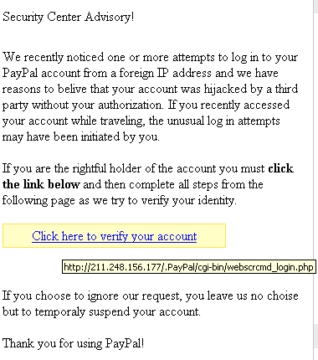
E-mail
No personal greeting
Sense of urgency
Uses images instead of text
Bypasses spam filters
Sender will look legitimate
Can be spoofed to look real
Links may take you to a strange URL

Slide 6
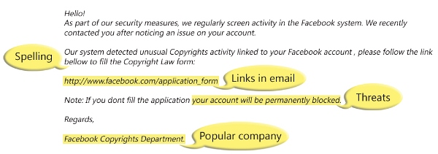
Another example

Slide 7
Random links
Links from Youtube comments, Facebook, chat rooms, and blogs
Majority of random links are spam or malware
Spamming fraudulent links is a career choice for criminals
Instead of clicking a link, google it first or type in the legitimate url from memory

Slide 8
Man in the middle (mitm)
When a hacker is inside your wifi network
Hacker plays a middle man between you and the legitimate site, where you send information to his fake page and he then sends it to the legitimate site and vise versa
Used often on public networks such as those found at Starbucks
Used on households who use WEP and/or weak wifi passwords
Refrain from entering personal information when on public networks

Slide 9
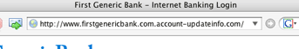
SPOT A PHISHING SITE
Domain is actually “account-updateinfo.com”
http://www.google.com@members.tripod.com/
Domain is tripod.com
Are not secured by SSL

Slide 10
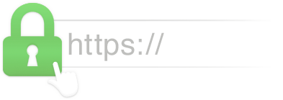
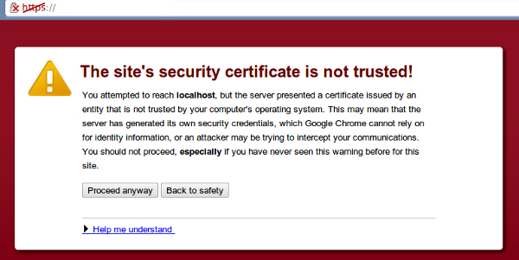
Encryption
Legitimate sites use SSL encryption
Look for “https” in the URL
SSL can be faked
Look for warnings from your browser

Slide 11
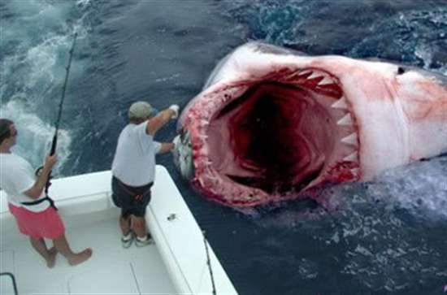
Don’t be a victim of phishing attacks

